Slide 1
Trong H. Truong
DevOps Engineer @ Endava Vietnam

Slide 2
What does a DevOps Engineer
really do?

Slide 3
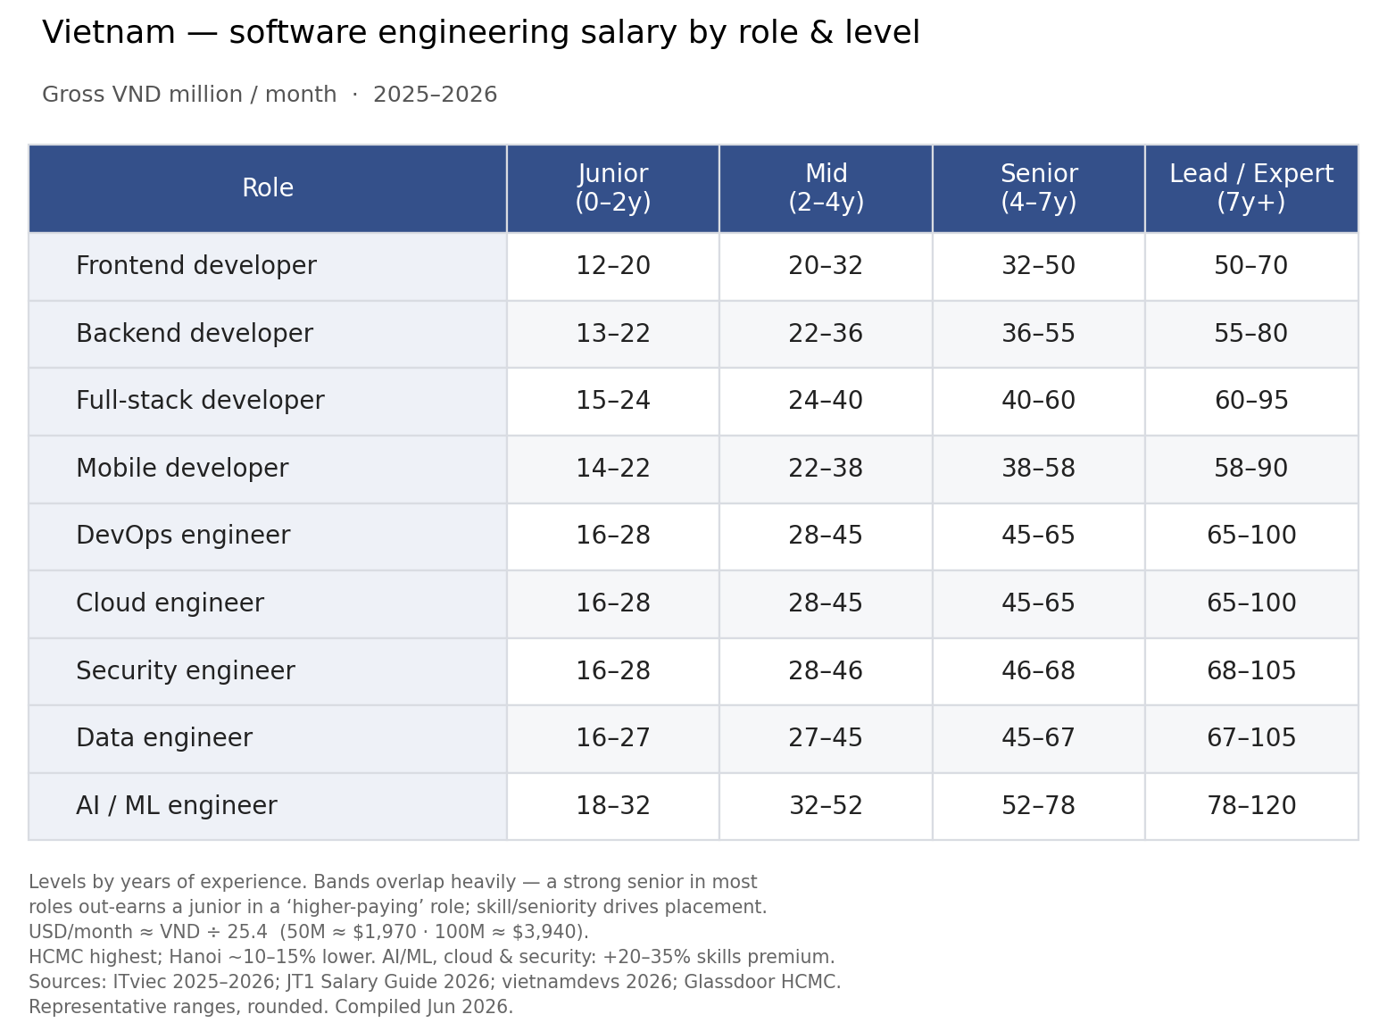
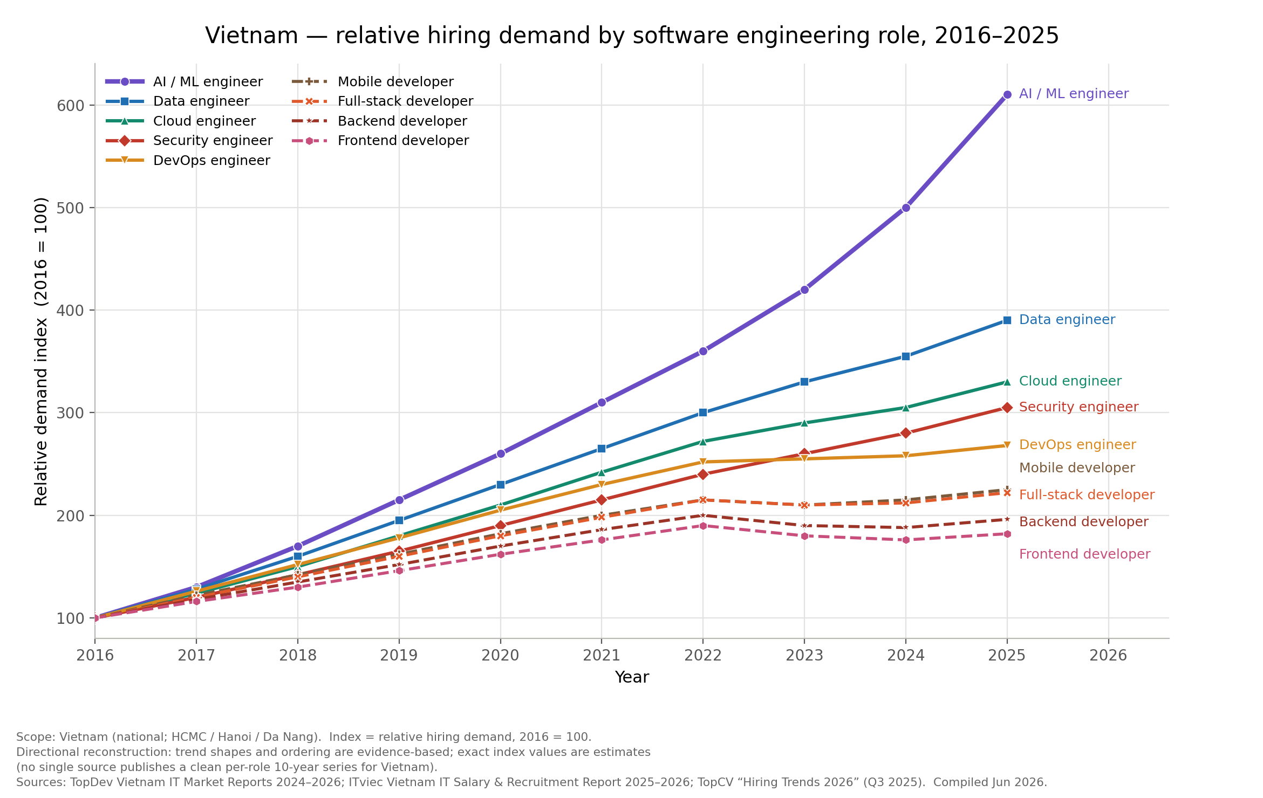
Why you interested in DevOps?

Slide 4
Why did I choose DevOps?

Slide 5
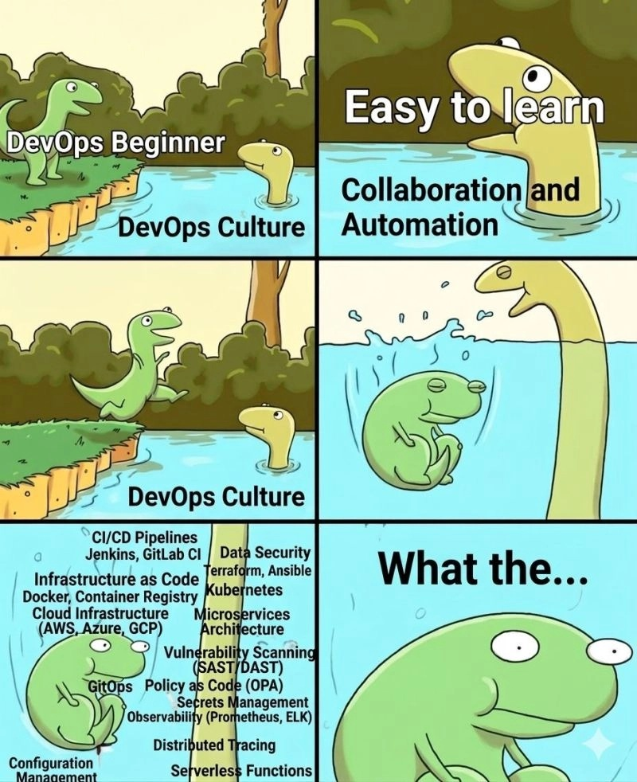
Why did I choose DevOps?
Actually... I didn't
ss

Slide 6
What people think DevOps is
Common JD needs
DevOps is a…
CI/CD pipelines
person who writes CI/CD pipelines
IaC and Configuration Management
Docker/Kubernetes person
Container and Orchestration (K8s)
cloud engineer/platform engineer
Cloud Providers (AWS, Azure)
the person who deploys code
Logging and monitoring
the person who fixes production at midnight

Slide 7

What DevOps really does in real life
https://camelial.github.io/essays/spiderman.html

Slide 8
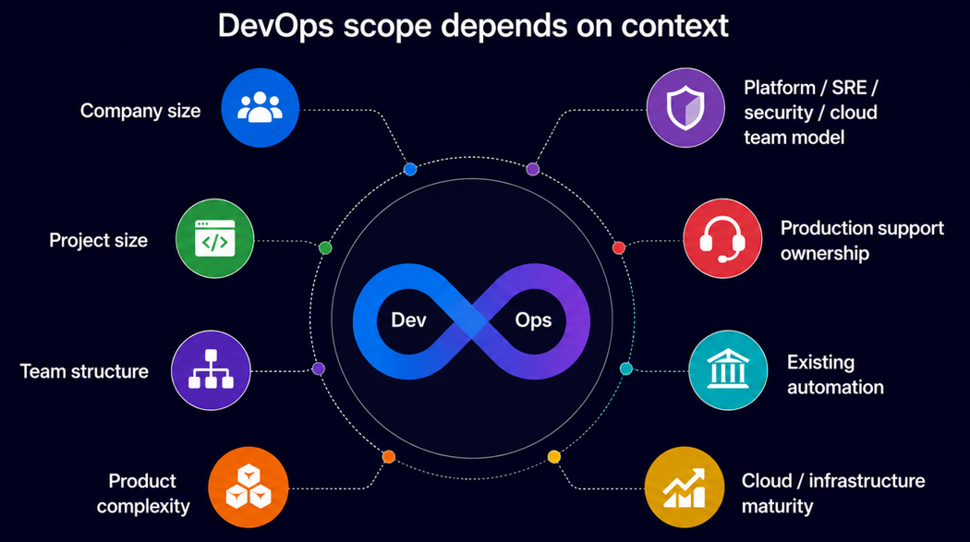
What DevOps really does in real life

Slide 9
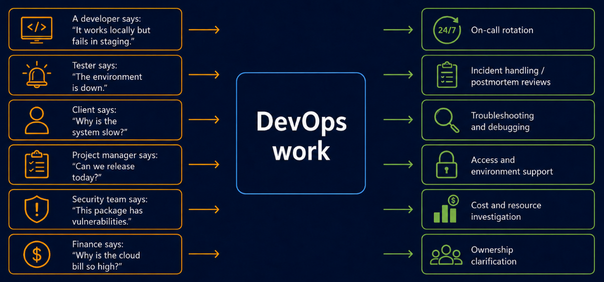
What DevOps really does in real life

Slide 10



What should you learn first?

Slide 11
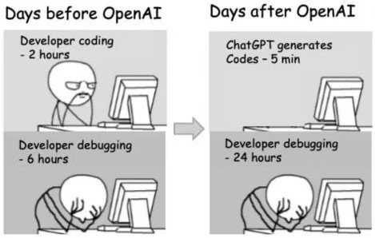
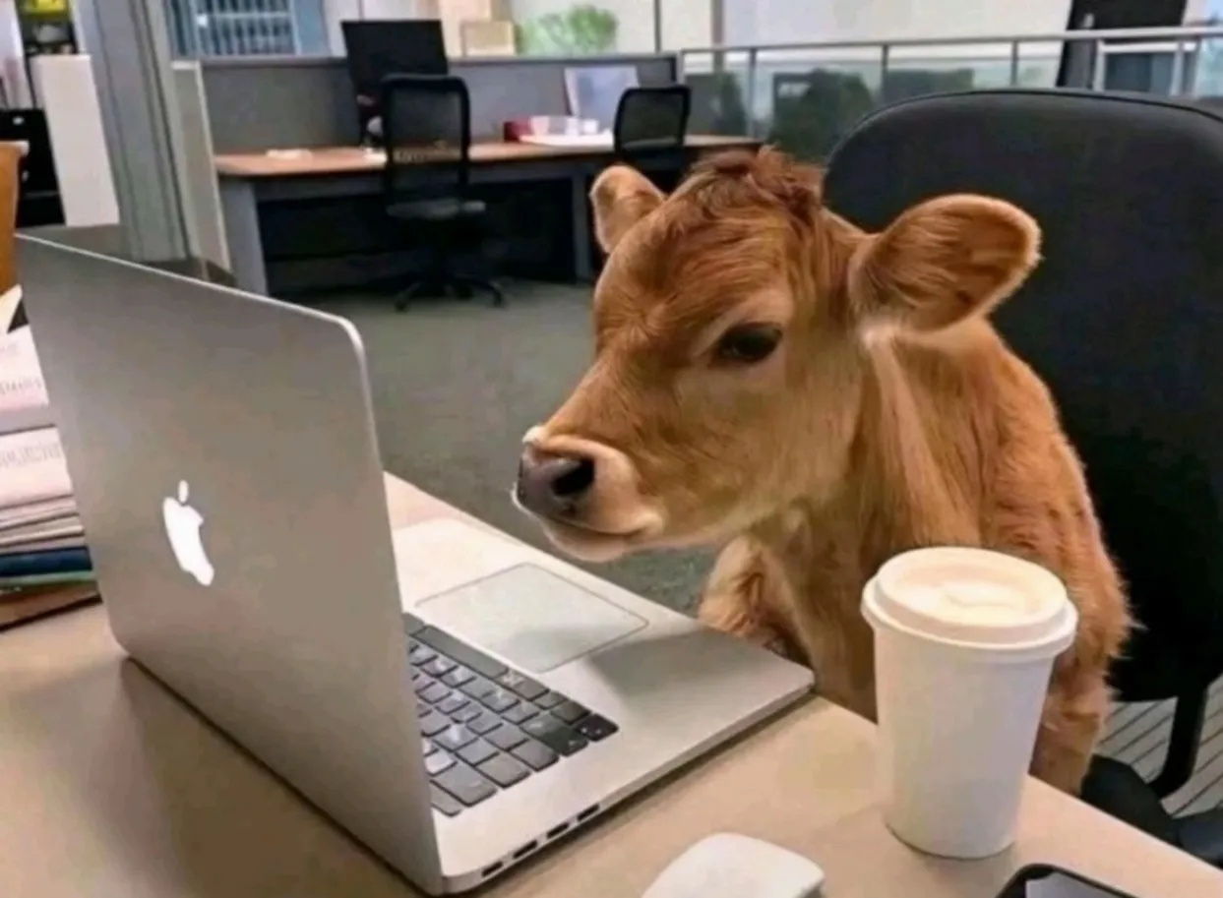
What should you learn first?
https://www.reddit.com/r/ProgrammerHumor/comments/11li031/ai_will_replace_us/
https://www.threads.com/@22th100/post/DQO3VsJElOT/media

Slide 12
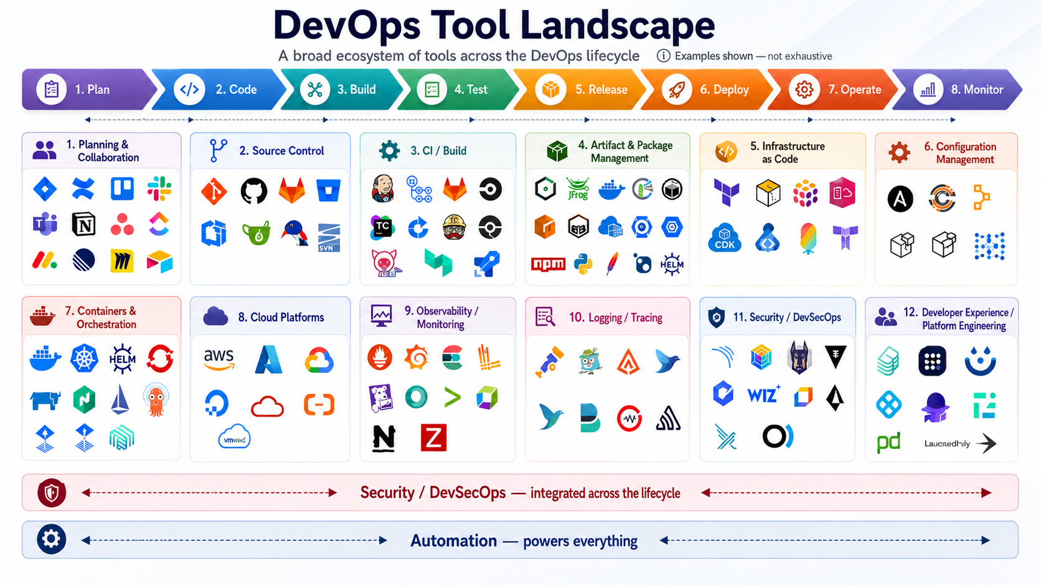
DevOps tool landscape

Slide 13
What should you learn first?
Fundamentals
Linux
Networking basics
Programming language: Python, Golang
Git and CI/CD
Containers
Understand how applications run
Build, test, deploy, logs, configuration, environment variables.
Build small projects
Deploy a simple app, automate something, monitor it, break it, fix it.

Slide 14
Things I learned the hard way
Copying commands is not the same as understanding
Learn to identify the real owner of the problem
Learned to ask “why” before “how”
Communication is part of the job
DevOps is not about being a hero

Slide 15
What makes a good DevOps engineer?
Tools change. Fundamentals stay.
Be curious
and keep learning.
Think in systems
not just tasks
Automate boring and repeatable work
Make things clear and easy for the team.
Use AI to leverage our skills, not to switch off your brain.

Slide 16
Q&A

Slide 17
Thank you

